Slide 1
Company Foto
Seungho Yang
Kevin Trochez
Binbin Xuan
Yun Ye
Gregory Szymanski

Slide 2
Agenda
Strategy recap
Strengths
Weakness
Market Conditions
Year 9 Projections

Slide 3
Strategy Recap & Adjustments - Gregory Szymanski
Overall cost leadership (Year 6)
Seek cost cuts in all parts of the value chain
Gain advantage through low price
2. Integrating overall low cost and differentiation (Year 7 - 8)
Create good quality products
Retain cost advantage

Slide 4
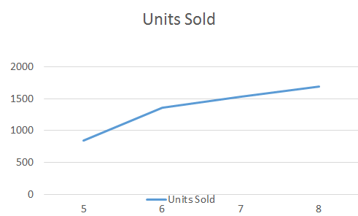
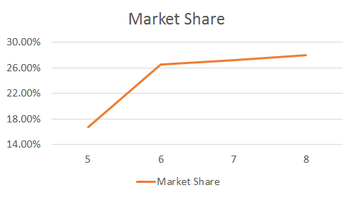
Strengths - Yun Ye
000s of unit
Market Share
Constant growth
Image Rating
Expectation met
Sales Revenues
High units sold
Most revenues

Slide 5
Weakness - Seungho Yang
AC Camera Operating Profit ($ / unit sold) | Average Yr 8 | Foto Yr 8
North America | 76.67 | -6.16
Europe-Africa | 72.71 | -1.05
Asia - Pacific | 37.35 | -2.18
Latin America | 47.49 | -1.34
AC Camera - Warranty Claim Rate & Repair Cost
Low operating profit for both products
Highest COGS : $381,811,000
Low Credit Rating
Long term bank loan (5years) - $30,000,000
Year 6 | Year 7 | Year 8
A | B+ | B-
Notes:
Loan - For company expansion
Low credit rating - tougher to get funded
High Warranty Claim Rate in all regions
Because of low cost strategy – low product quality

Slide 6
Market Conditions - Kevin Trochez
Action-Capture Camera
Demand for AC Cameras is expected to increase by about 6.3% annually
UAV Drone
Demand for Drones is expected to increase by about 12.8% annually
Given the markets conditions we will continue with:
Higher p/q rating
Increase the number of models available
Increase marketing spending
Longer warranties

Slide 7
Year 9 Projections - Binbin Xuan
Demand forecast increase (000s of units)
AC camera: 6,042 to 6,457
Drone : 1,236 to 1,423
Revenue increase by 19.2% from year 8
P/Q rating increase
AC camera: from 1.1 to 2.0
Drone : from 2.6 to 4.1
Drone market share is increasing
1.6% in North America
0.3% in Europe-Africa
2.0% in Asia-Pacific
1.2% in Latin America
Notes:
Highlight the numbers and keywords
Edit the text 1.Operating profit decrease, in order to invest more money into products
2.Lower market cost leading to Slight decrease on market share
Operating pr

